Slide 1
CHAPTER
8 Game Theory

Slide 2
Basic Concepts
In a strategic setting
  A person may not always have an obvious choice of what is best
    May depend on the actions of another person
Using game theory to analyze an economic situation
  Distill the situation into a simple game
  Solve the game
    Results in a prediction about what will happen

Slide 3
Basic Concepts
A game
  An abstract model of a strategic situation
Three elements to a game
  Players
  Strategies
  Payoffs

Slide 4
Basic Concepts
Players: each decision maker
    May be individuals, firms, countries, etc.
    Have the ability to choose from among a set of possible actions
Strategy: each course of action open to a player
    It may be a simple action or a complex plan of action
    S_{i} is the set of strategies open to player i
    s_{i} is the strategy chosen by player i, s_{i} ∈ S_{i}

Slide 5
Basic Concepts
Payoffs
  Are measured in levels of utility obtained by the players
  Players are assumed to prefer higher payoffs to lower ones
    U₁(s₁,s₂) denotes player 1’s payoff assuming she follows s₁ and player 2 follows s₂
    U₂(s₂, s₁) would be player 2’s payoff under the same circumstances

Slide 6
Prisoners’ Dilemma
The Prisoners’ Dilemma
  One of the most famous games studied in game theory
  Two suspects are arrested for a crime
  The DA wants to extract a confession so he offers each a deal

Slide 7
Prisoners’ Dilemma
The Deal
  “If you fink on your companion, but your companion doesn’t fink on you, you get a one-year sentence and your companion gets a four-year sentence”
  “If you both fink on each other, you will each get a three-year sentence”
  “If neither finks, we will get tried for a lesser crime and each get a two-year sentence”

Slide 8
Prisoners’ Dilemma
There are 4 combinations of strategies and two payoffs for each combination
  Useful to use a game tree or a matrix to show the payoffs
    A game tree is called the extensive form
    A matrix is called the normal form

Slide 9
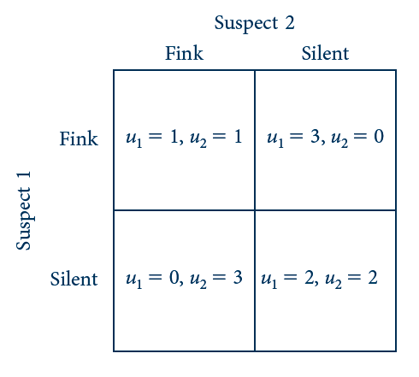
8.1 Normal Form for the Prisoners’ Dilemma
U₁ = 1, U₂ = 1
U₁ = 3, U₂ = 0
U₁ = 0, U₂ = 3
U₁ = 2, U₂ = 2
Two suspects simultaneously choose to fink or be silent. Rows refer to player 1’s actions and columns to player 2’s. Each box is an outcome; the first entry is player 1’s payoff and the second player 2’s in that outcome.

Slide 10
Nash Equilibrium
Nash equilibrium
  Involves strategic choices that, once made, provide no incentives for players to alter their behavior
  Best choice for each player given the other players’ equilibrium strategies

Slide 11
Nash Equilibrium
Best response
  s_{i} is the best response for player i to rivals’ strategies s_{-i}, denoted s_{i} ∈ BR_{i}(s_{-i}) if
U_{i}(s_{i},s_{-i}) ≥ u_{i}(s’_{i},s_{-i}) for all s’_{i} ∈ S_{i}
A Nash equilibrium
  Is a strategy profile (s*₁,s*₂,…s*_{n})
  Such that s*_{i} is a best response to other players’ equilibrium strategies, s*_{-i} or
s*_{i} ∈ BR_{i}(s*_{-i})

Slide 12
Nash Equilibrium
In a 2-player game, (s*₁,s*₂) is a Nash equilibrium if
U₁(s*₁,s*₂) ≥ U₁(s₁,s*₂) for all s₁ ∈ S₁
U₂(s*₂,s*₁) ≥ U₂(s₂,s*₁) for all s₂ ∈ S₂
Drawbacks to Nash equilibrium
    There may be multiple Nash equilibria
    It is unclear how a player can choose a best-response strategy before knowing how rivals will play

Slide 13
Nash Equilibrium in Prisoners’ Dilemma
Finking is player 1’s best response to player 2’s finking
  The same logic applies for player 2
If player 2 finks
  If player 1 also finks, his payoff is 1
  If player 1 is silent, his payoff is 0
    Best response: fink
Players are symmetric
  Best response for player 2: fink

Slide 14
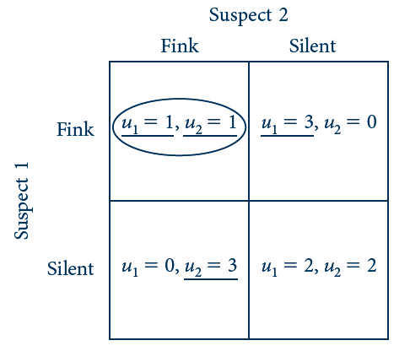
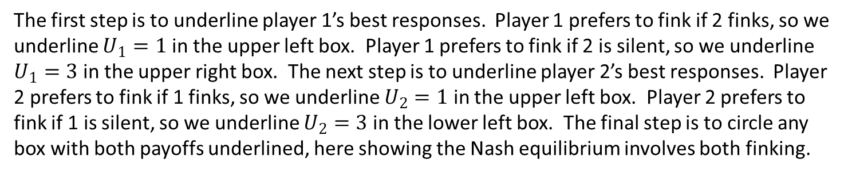
8.2 Underlining Procedure in the Prisoners’
Dilemma
U₁ = 1, U₂ = 1
U₁ = 3, U₂ = 0
U₁ = 0, U₂ = 3
U₁ = 2, U₂ = 2
The first step is to underline player 1’s best responses. Player 1 prefers to fink if 2 finks, so we underline $U_{1}=1$ in the upper left box. Player 1 prefers to fink if 2 is silent, so we underline $U_{1}=3$ in the upper right box. The next step is to underline player 2’s best responses. Player 2 prefers to fink if 1 finks, so we underline $U_{2}=1$ in the upper left box. Player 2 prefers to fink if 1 is silent, so we underline $U_{2}=3$ in the lower left box. The final step is to circle any box with both payoffs underlined, here showing the Nash equilibrium involves both finking.

Slide 15
Dominant Strategies
Dominant strategy
  A strategy that is a best response to any strategy the other players might choose
  Finking is a dominant strategy for both players
  s*_{i} ∈ BR_{i}(s_{-i}) for all s_{-i}
When a dominant strategy exists, it is the unique Nash equilibrium

Slide 16
Battle of the Sexes
A wife and husband may either go to the ballet or to a boxing match
  Both prefer spending time together
  The wife prefers ballet and the husband prefers boxing
There are two Nash equilibria
  Both going to the ballet
  Both going to boxing
There is no dominant strategy

Slide 17
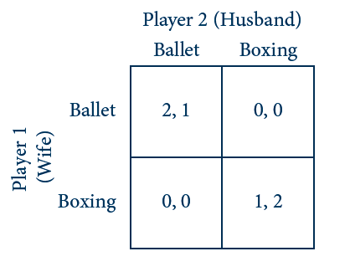
8.3 Normal Form for the Battle of the Sexes
The wife and husband simultaneously choose which event, ballet or boxing, to show up to. They obtain 0 payoff if they do not end up coordinating.

Slide 18
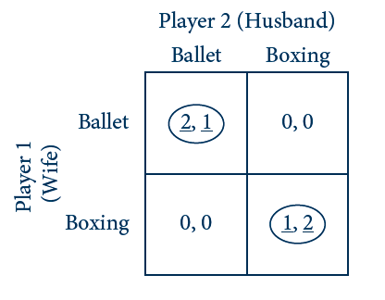
8.4 Underlining Procedure in the
Battle of the Sexes
The underlining procedure yields two Nash equilibria in pure strategies: both go to ballet and both go to boxing.

Slide 19
8.1 Rock, Paper, Scissors
Two players simultaneously display one of three hand signals
  Rock breaks scissors
  Scissors cut paper
  Paper covers rock
None of the nine boxes represents a Nash equilibrium
  Any strategy pair is unstable because it offers at least one of the players an incentive to deviate

Slide 20
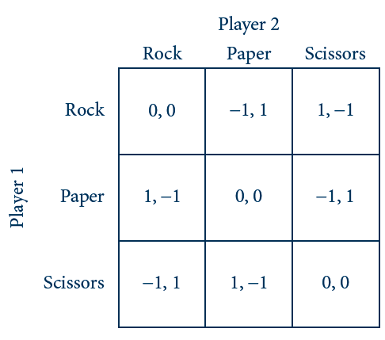
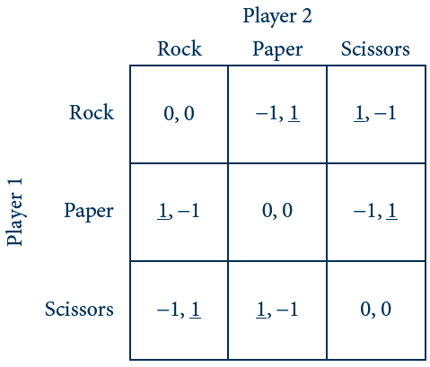
8.5 Rock, Paper, Scissors
(a) Normal form
(b) Underlining procedure
Rock, Papers, Scissors involves three strategies for each player. The underlining procedure shows that it has no Nash equilibrium in pure strategies.

Slide 21
Mixed Strategies
Pure strategy
  When a player chooses one action of another with certainty
Mixed strategies
  Players may randomly select from several possible actions

Slide 22
Mixed Strategies
Reasons for studying mixed strategies
  Some games have no nash equilibria in pure strategies but will have one in mixed strategies
  Strategies involving randomization are familiar and natural in certain settings
  It is possible to “purify” mixed strategies

Slide 23
Mixed Strategies
Suppose that player i has a set of M possible actions, A_{i} = {a¹_{i},…a^{m}_{i},…,a^{M}_{i}}
  A mixed strategy is a probability distribution over the M actions,
  s_{i} = (σ¹_{i},…,σ^{m}_{i},…,σ^{M}_{i})
  σ^{m}_{i} indicates the probability of player i playing action a^{m}_{i}
    0 ≤ σ^{m}_{i} ≤ 1
    σ¹_{i}+…+σ^{m}_{i}+…+σ^{M}_{i} = 1

Slide 24
Mixed Strategies
Battle of the Sexes
  A₁=A₂={ballet, boxing}
  A mixed strategy (σ, 1-σ)
    σ = probability that the player chooses ballet
    (1/3, 2/3): Player plays ballet with probability 1/3 and boxing with probability 2/3
    (1/2, 1/2): Player is equally likely to play ballet or boxing
    (1, 0): Player chooses ballet with certainty
    (0, 1): Player chooses boxing with certainty

Slide 25
Mixed Strategies
A pure strategy
  Is a special case of a mixed strategy
  Only one action is played with positive probability
Strictly mixed strategies
  Mixed strategies that involve two or more actions being played with positive probability

Slide 26
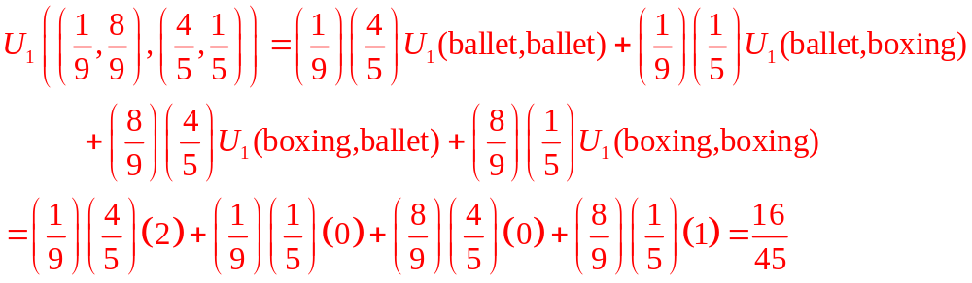
8.2 Expected Payoffs in the
Battle of the Sexes
Suppose the wife chooses mixed strategy (1/9,8/9) and the husband chooses (4/5,1/5)
The wife’s expected payoff is

Slide 27
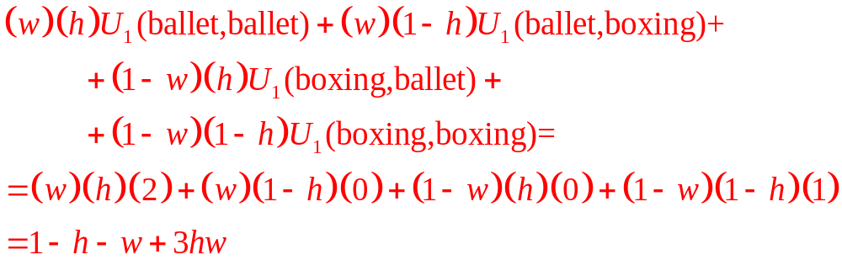
8.2 Expected Payoffs in the
Battle of the Sexes
Suppose the wife chooses mixed strategy (w,1-w) and the husband chooses (h,1-h)
  The wife plays ballet with probability w and the husband with probability h
Her expected payoff becomes U((w, 1-w), (h, 1-h))=

Slide 28
8.3 Mixed-Strategy Nash Equilibrium in the
Battle of the Sexes
General mixed strategy: the wife chooses (w,1-w) and the husband chooses (h,1-h)
Wife’s expected payoff:
  U₁((w, 1-w), (h, 1-h))= 1 – h – w + 3hw
The wife’s best response depends on h
  If h < 1/3, she should set w = 0
  If h > 1/3, she should set w = 1
  If h = 1/3, her expected payoff is the same no matter what value of w she chooses

Slide 29
8.3 Mixed-Strategy Nash Equilibrium in the
Battle of the Sexes
Husband’s expected payoff:
  U₂((h, 1-h), (w, 1-w))= 2 – 2h – 2w + 3hw
The husband’s expected payoff is maximized
  when w < 2/3, he should set h = 0
  when w > 2/3, he should set h = 1
  when w = 2/3, his expected payoff is the same no matter what value of h he chooses

Slide 30
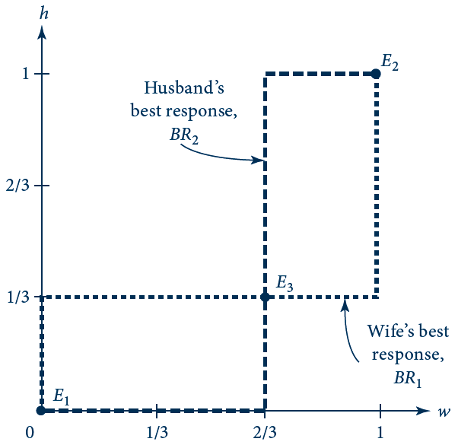
8.6 Nash Equilibria in Mixed Strategies in the
Battle of the Sexes
Ballet is chosen by the wife with probability w and by the husband with probability h. Players’ best responses are graphed on the same set of axes. The three intersection points E₁, E₂, and E₃ are Nash equilibria. The Nash equilibrium in strictly mixed strategies, E₃, is w*=2/3 and h*=1/3.

Slide 31
Mixed Strategies
A player
  Randomizes over only those actions among which he or she is indifferent
One player’s indifference condition
  Pins down the other player’s mixed strategy

Slide 32
Existence Of Equilibrium
Nash proved the existence of a Nash equilibrium in all finite games
  The existence theorem does not guarantee the existence of a pure-strategy Nash equilibrium
  It does guarantee that, if a pure-strategy Nash equilibrium does not exist, a mixed-strategy Nash equilibrium does

Slide 33
Continuum of Actions
Some settings
  Are more realistically modeled via a continuous range of actions
Using calculus to solve for Nash equilibria
  Makes it possible to analyze how the equilibrium actions vary with changes in underlying parameters

Slide 34
Tragedy of the Commons
Solve for the Nash equilibrium when the game involves a continuum of actions
    Write down the payoff for each player as a function of all players’ actions
    Compute the first-order condition associated with each player’s payoff maximum
      Equation - can be rearranged into the best response of each player as a function of all other players’ actions
      Solve the system of n equations for the n unknown equilibrium actions

Slide 35
8.4 Tragedy of the Commons
The “Tragedy of the Commons”
  Describes the overuse that arises when scarce resources are treated as common property
  Two herders decide how many sheep to graze on the village commons
  The commons is quite small and can rapidly succumb to overgrazing
  q_{i} = the number of sheep chosen by herder i
  Per-sheep value of grazing on the commons is
v(q₁,q₂) = 120 – (q₁ + q₂)

Slide 36
8.4 Tragedy of the Commons
The “Tragedy of the Commons”
  The normal form is a listing of the herders’ payoff functions
U₁(q₁,q₂) = q₁v(q₁,q₂) = q₁(120 – q₁ – q₂)
U₂(q₁,q₂) = q₂v(q₁,q₂) = q₂(120 – q₁ – q₂)
Solve for the Nash equilibrium
  Solve herder 1’s maximization problem and get his best-response function: q₁=60-q₂/2=BR₁(q₂)
  Solve herder 2’s maximization problem and get his best-response function: q₂=60-q₁/2=BR₂(q₁)
  The Nash equilibrium: q*₁=q*₂=40, payoff=1,600

Slide 37
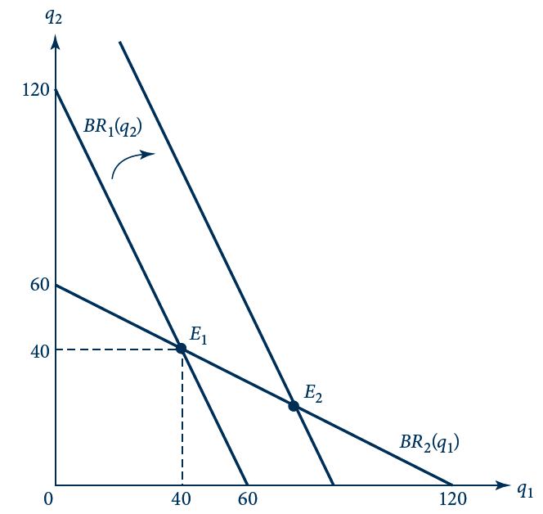
8.7 Best-Response Diagram for the
Tragedy of the Commons
The intersection, E₁, between the two herders’ best responses is the Nash equilibrium. An increase in the per-sheep value of grazing in the Tragedy of the Commons shifts out herder 1’s best response, resulting in a Nash equilibrium E₂ in which herder 1 grazes more sheep (and herder 2, fewer sheep) than in the original Nash equilibrium.

Slide 38
8.4 Tragedy of the Commons
Suppose the per-sheep value of grazing rises for herder 1
  Would result in more sheep for herder 1 and fewer for herder 2
The Nash equilibrium is not the best use of the commons
  If both herders grazed 30 sheep each, their payoffs would rise
Solving a joint-maxizimization problem will lead to the higher payoffs

Slide 39
Sequential Games
In some games, the order of moves matters
  A player that can move later in the game can see how others have played up to that point

Slide 40
Sequential Battle of the Sexes
Suppose the wife chooses first
  And the husband observes her choice before making his
  Her possible strategies haven’t changed
  His possible strategies have expanded
    For each of his wife’s actions, he can choose one of two actions

Slide 41
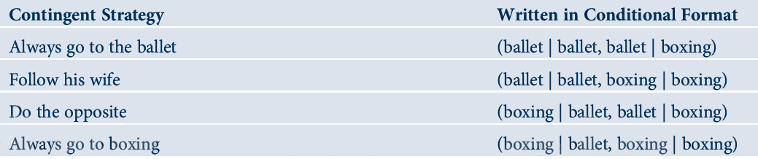
8.1 Husband’s contingent strategies

Slide 42
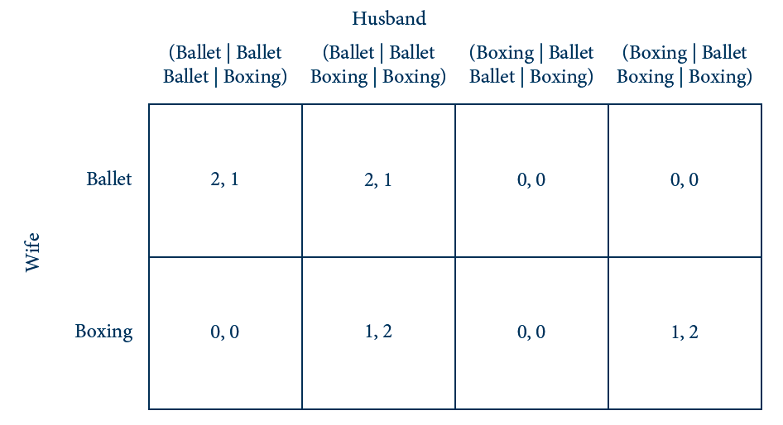
8.8 Normal Form for the Sequential
Battle of the Sexes
The column player (husband) has more complicated, contingent strategies in the sequential Battle of the Sexes. The normal form expands to reflect his expanded strategy space.

Slide 43
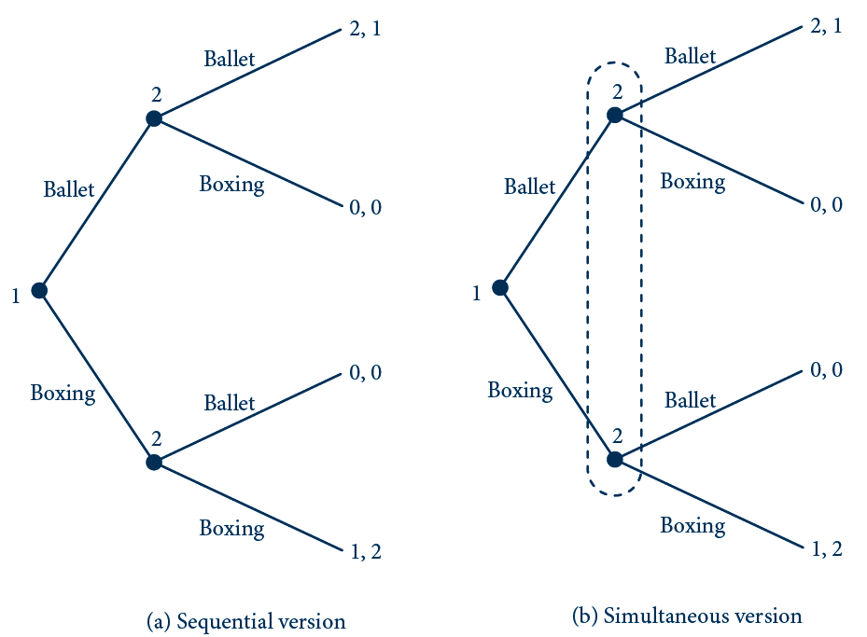
8.9 Extensive Form for the Battle of the Sexes
In the sequential version (a), the husband moves second, after observing his wife’s move. In the simultaneous version (b), he does not know her choice when he moves, so his decision nodes must be connected in one information set.

Slide 44
Sequential Battle of the Sexes
There are three pure-strategy Nash equilibria
  Wife plays ballet, husband plays (ballet | ballet, ballet | boxing)
  Wife plays ballet, husband plays (ballet | ballet, boxing | boxing)
  Wife plays boxing, husband plays (boxing | ballet, boxing | boxing)

Slide 45
Subgame-Perfect Equilibrium
A subgame
  A part of the extensive form beginning with a decision node and including everything to the right of it
A proper subgame
  Starts at a decision node not connected to another in an information set

Slide 46
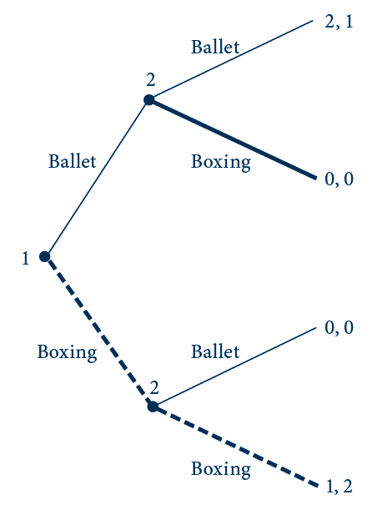
8.10 Equilibrium Path
In the third of the Nash equilibria listed for the sequential Battle of the Sexes, the wife plays boxing and the husband plays (boxing | ballet, boxing | boxing), tracing out the branches indicated with thick lines (both solid and dashed). The dashed line is the equilibrium path; the rest of the tree is referred to as being ‘‘off the equilibrium path.’’

Slide 47
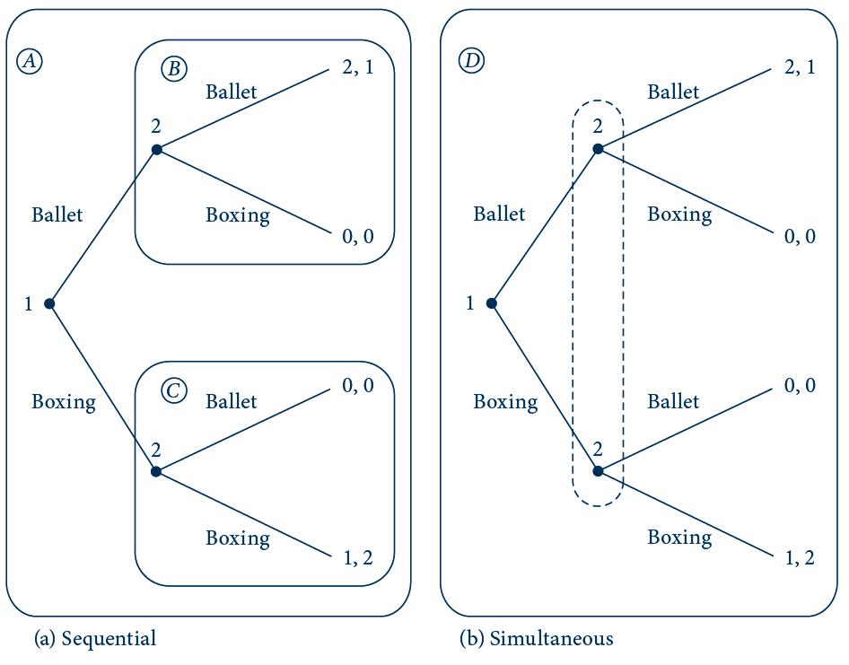
8.11 Proper Subgames in the Battle of the Sexes
The sequential version in (a) has three proper subgames, labeled A, B, and C. The simultaneous version in (b) has only one proper subgame: the whole game itself, labeled D.

Slide 48
Subgame-Perfect Equilibrium
A subgame-perfect equilibrium
  A strategy profile (s*₁,s*₂,…,s*_{n}) that constitutes a Nash equilibrium for every proper subgame
  Is always a Nash equilibrium
  Rules out any empty threat in a sequential game

Slide 49
Backward Induction
Backward induction
  A shortcut for finding the perfect-subgame equilibrium directly
  Working backwards from the end of the game to the beginning
    Compute the Nash equilibria for the bottommost subgames at the husband’s decision nodes
    Substitute his equilibrium strategies for the subgames themselves
    The resulting game is a simple decision problem for the wife

Slide 50
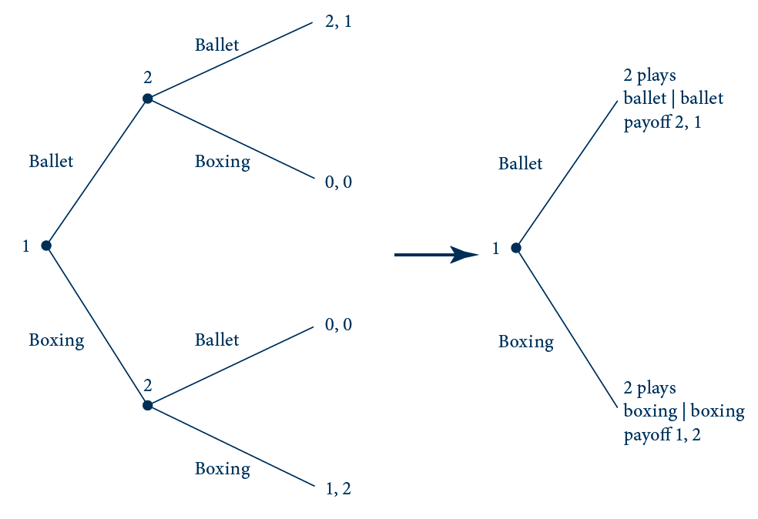
8.12 Applying Backward Induction
The last subgames (where player 2 moves) are replaced by the Nash equilibria on these subgames. The simple game that results at right can be solved for player 1’s equilibrium action.

Slide 51
Repeated Games
Stage game
  Simple constituent game that is played repeatedly
Repeated play
  Opens up the possibility of cooperation in equilibrium
  Players can adopt trigger strategies
    Cooperate as long as everyone else does

Slide 52
Finitely Repeated Games
Repeat a stage game for a known, finite number of times
  May not increase the possibility for cooperation
Selten’s theorem
  For any stage game with a unique Nash equilibrium
  The unique subgame-perfect equilibrium of the finitely repeated game
  Involves playing Nash equilibrium every period

Slide 53
Finitely Repeated Games
If the stage game has multiple Nash equilibria
  It may be possible to achieve cooperation in a finitely repeated game
  Players can use trigger strategies to maintain cooperation
    Threaten to play the Nash equilibrium that yields a worse outcome for the player who deviates from cooperation

Slide 54
Infinitely Repeated Games
Players can sustain cooperation in infinitely repeated games
  By using trigger strategies
  The trigger strategy must be severe enough to deter deviation

Slide 55
Infinitely Repeated Games
Both players follow a trigger strategy in the Prisoners’ Dilemma
  If both players are silent every period, the payoff over time would be
  V^{eq} = 2 + 2δ + 2δ² + … = 2/(1–δ)
  If a player deviates and then the other finks every period, that player’s payoff is
  V^{dev} = 3 + 1δ + 1δ² + … = 3 + δ/(1–δ)
  Trigger strategies form a perfect-subgame equilibrium: V^{eq} ≥ V^{dev,} so δ ≥ 1/2

Slide 56
Infinitely Repeated Games
Grim strategy
  The trigger strategy in which players revert to the harshest punishment possible
  Revert to stage-game Nash equilibrium forever
  Elicits cooperation for the lowest value of δ for any strategy
A tit-for-tat strategy
    Involves only one round of punishment for cheating

Slide 57
Infinitely Repeated Games
As δ approaches 1
  Grim-strategy punishments become infinitely harsh
    Because they involve an unending stream of undiscounted losses
  Infinite punishments can be used to sustain a wide range of possible outcomes

Slide 58
Incomplete Information
Some players
  Have information about the game that others do not
Players that lack full information
  Will try to use what they do know to make inferences about what they do not

Slide 59
Simultaneous Bayesian Games
A two-player
  Simultaneous-move game
  In which player 1 has private information
  But player 2 does not
We can model private information
  By introducing player types

Slide 60
Player Types and Beliefs
Player 1
  Can be of a number of possible types, t
  Knows his own type
Player 2
  Is uncertain about t
  Must decide strategy based on her beliefs about t

Slide 61
Player Types and Beliefs
The game begins at a chance node
  At which a value of t_{k} is drawn for player 1 from a set of possible types,
  T = {t₁,…,t_{k},…,t_{K}}
  Pr(t_{k}) = probability of drawing type t_{k}
  Player 1 sees which type is drawn
  Player 2 does not see which type is drawn
    Only knows the probabilities

Slide 62
Player Types and Beliefs
Since player 1 observes t before moving
  His strategy can be conditioned on t
    Let s₁(t) be 1’s strategy contingent on his type
    Player 2’s strategy is an unconditional one, s₂
Player 1’s type may affect player 2’s payoff in two ways
  Directly
  Indirectly through player 1’s strategy

Slide 63
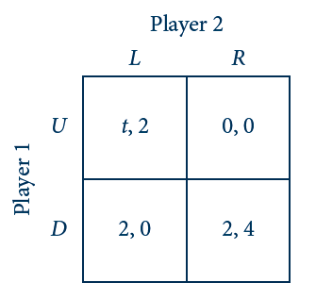
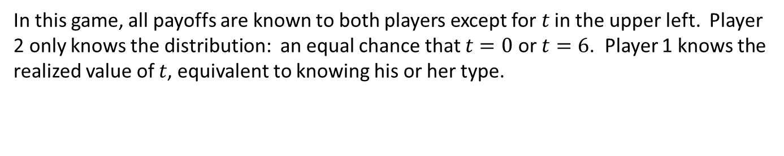
8.13 Simple Game of Incomplete Information
Left
Right
Up
Down
In this game, all payoffs are known to both players except for $t$ in the upper left. Player 2 only knows the distribution: an equal chance that $t=0$ or $t=6$. Player 1 knows the realized value of $t$, equivalent to knowing his or her type.

Slide 64
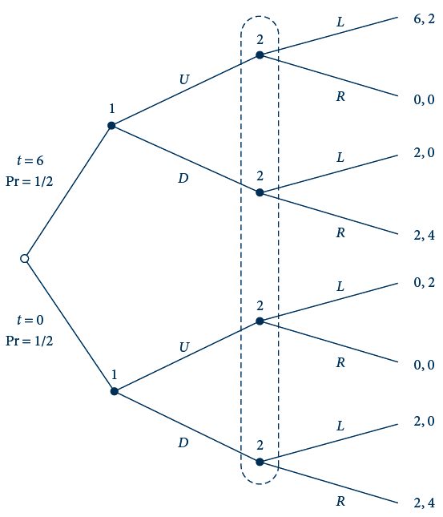
8.14 Extensive Form for Simple Game of
Incomplete Information
Left
Up
This figure translates Figure 8.13 into an extensive-form game. The initial chance node is indicated by an open circle. Player 2’s decision nodes are in the same information set because she does not observe player 1’s type or action before moving.
Right
Left
Down
Right
Left
Up
Right
Left
Down
Right

Slide 65
Bayesian-Nash Equilibrium
Equilibrium requires that
  1’s strategy be the best response for each and every one of his types
  2’s strategy maximize an expected payoff
    The expectation is taken with respect to her beliefs about 1’s type

Slide 66
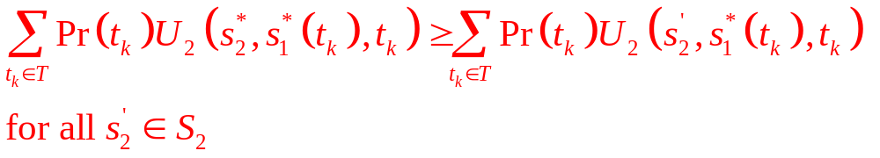
Bayesian-Nash Equilibrium
Bayesian-Nash equilibrium
  In a two-player simultaneous move game in which player 1 has private information,
  Is a strategy profile (s*₁(t),s*₂) such that
U₁(s*₁(t),s*₂,t) ≥ U₁(s’₁,s*₂,t) for all s’₁ ∈ S₁
  and

Slide 67
8.5 Bayesian–Nash Equilibrium of Game in Figure 8.14
Two possible candidates for an equilibrium in pure strategies
  1 plays (Up|t=6, Down|t=0) and 2 plays Left
    Not an equilibrium
  1 plays (Down|t=6, Down|t=0) and 2 plays Right
    A Bayesian-Nash equilibrium

Slide 68
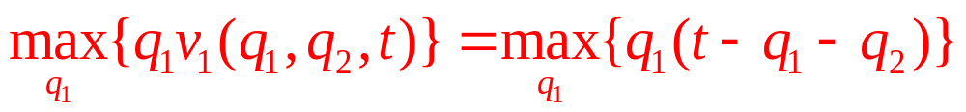
8.6 Tragedy of the Commons as a
Bayesian Game
Herder 1
  Has private information regarding his value of grazing per sheep, v₁(q₁,q₂,t)=t-(q₁+q₂)
  His type is
    t=130 (the ‘‘high’’ type) with probability 2/3
    t=100 (the ‘‘low’’ type) with probability 1/3
  Value-maximization problem:
  First-order condition: t-2q₁-q₂=0
  So, q_{1H}=65-q₂/2 and q_{1L}=50-q₂/2

Slide 69
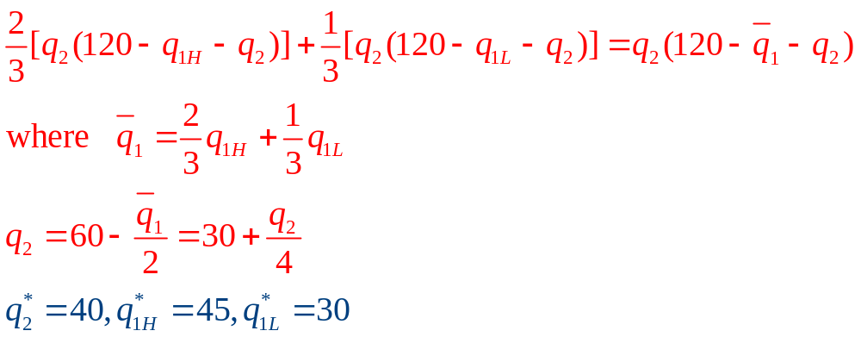
8.6 Tragedy of the Commons as a
Bayesian Game
Herder 2
  Expected payoff:

Slide 70
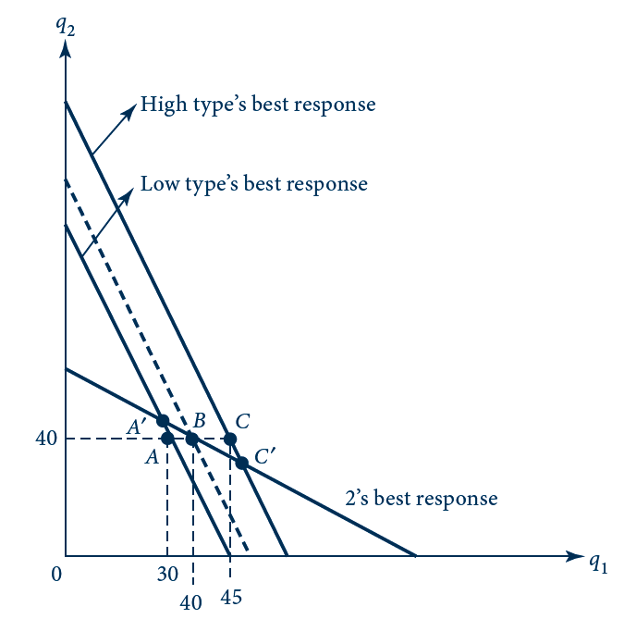
8.15 Equilibrium of the Bayesian Tragedy of the
Commons
Best responses for herder 2 and both types of herder 1 are drawn as thick solid lines; the expected best response as perceived by 2 is drawn as the thick dashed line. The Bayesian–Nash equilibrium of the incomplete-information game is given by points A and C; Nash equilibria of the corresponding full-information games are given by points A’ and C’ .

Slide 71
Signaling Games
Signaling game
  Occurs in a sequential game with private information
  The informed player (player 1 ) takes an action that is observable to player 2 before 2 moves
    Player 1’s action can serve as a signal to player 2 that can be used to update her beliefs about player 1’s type

Slide 72
Job-Market Signaling
Player 1 can be of two types
  Highly skilled (t = H)
  Low skilled (t = L)
Player 2 is a firm considering hiring player 1
  Low-skilled worker generates no revenue for the firm
  High-skilled worker generates revenue of π

Slide 73
Job-Market Signaling
Wage = w
  Received by the worker, if hired, regardless of type; π > w > 0
The firm cannot observe the worker’s skill, only his education level
  Let c_{L} be the cost of obtaining an education for the low type
  Let c_{H} be the cost of obtaining an education for the high type, c_{H}< c_{L}

Slide 74
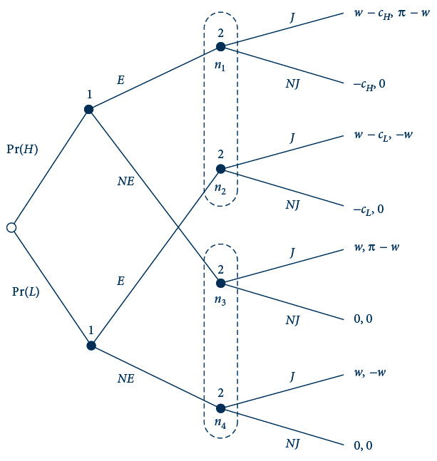
8.16 Job-Market Signaling
Player 1 (worker) observes his or her own type. Then player 1 chooses to become educated (E) or not (NE). After observing player 1’s action, player 2 (firm) decides to make him or her a job offer (J ) or not (NJ). The nodes in player 2’s information sets are labeled n₁,…, n₄ for reference.

Slide 75
Job-Market Signaling
Player 1
  Observes his type before moving
Player 2
  Only observes player 1’s action (education signal) before moving
  Expected payoff from playing J is
Pr(H|E)(π - w) + Pr(L|E)(-w) = Pr(H|E)π - w

Slide 76
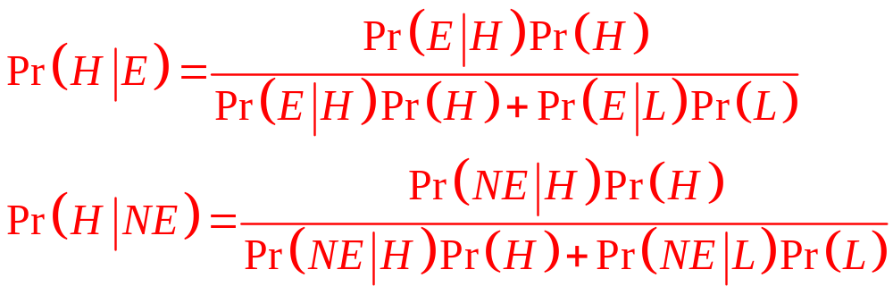
Bayes’ Rule

Slide 77
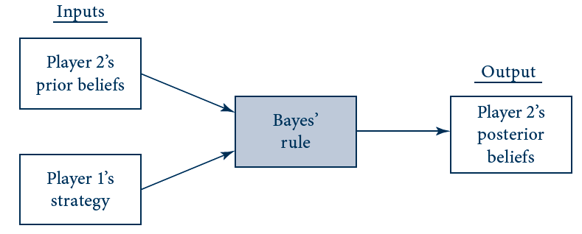
8.17 Bayes’ Rule as a Black Box
Bayes’ rule is a formula for computing player 2’s posterior beliefs from other pieces of information in the game.

Slide 78
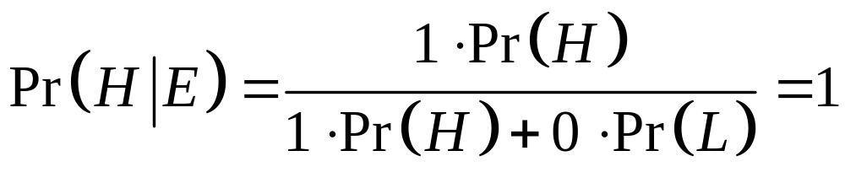
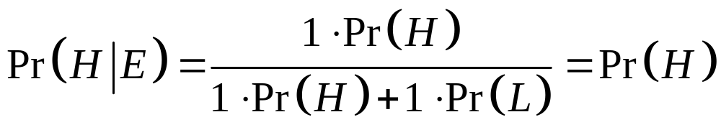
Bayes’ Rule
When player 1 plays a pure strategy
  Bayes’ rule often gives a simple result
Suppose that Pr(E|H) = 1 and Pr(E|L)=0
Suppose that Pr(E|H) = Pr(E|L)=1

Slide 79
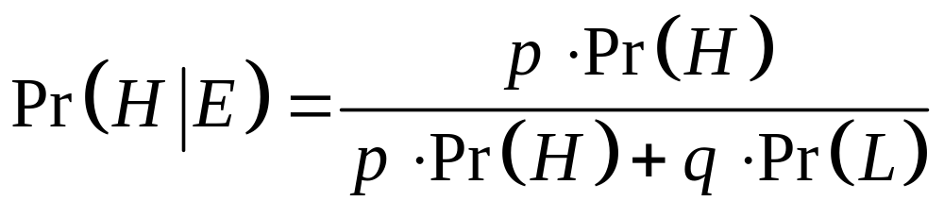
Bayes’ Rule
More generally, when player 1 plays the mixed strategy
Pr(E|H) = p and Pr(E|L)= q
Then Bayes’ rule implies:

Slide 80
Perfect Bayesian Equilibrium
A perfect Bayesian equilibrium
  Consists of a strategy profile and a set of beliefs such that at each information set
    The strategy of a player moving there maximizes his expected payoff
      The expectation is taken with respect to his beliefs
    The beliefs of the player moving there are formed using Bayes’ rule

Slide 81
Perfect Bayesian Equilibrium
Signaling games may have multiple equilibria
  Separating, Pooling, Hybrid
Separating equilibrium
  Each type of player chooses a different action
  Player 2 learns player 1’s type with certainty after 1 moves

Slide 82
Perfect Bayesian Equilibrium
Pooling equilibrium
  Different types of player 1 choose the same action
  Observing player 1’s move provides player 2 with no additional information

Slide 83
Perfect Bayesian Equilibrium
Hybrid equilibrium
  One type of player 1 plays a strictly mixed strategy
  Player 2 learns a little about player 1’s type but doesn’t learn it with certainty
  Player 2 may respond by also playing a mixed strategy

Slide 84
8.7 Separating Equilibrium in the
Job-Market Signaling Game
High-skilled worker
  Signals his or her type by getting an education
Player 2’s beliefs
  Pr(H|E)=Pr(L|NE)=1
  Pr(H|NE)=Pr(L|E)=0
Player 2’s response
  Offer a job if he observes that player 1 obtains an education
  Not offer a job if he observes that player 1 does not obtain an education

Slide 85
8.7 Separating Equilibrium in the
Job-Market Signaling Game
Check: player 1 would not want to deviate from the separating strategy (E|H, NE|L)
  Given that player 2 plays (J|E, NJ|NE)
Separating equilibrium
  The worker obtains an education if and only if he is high-skilled
  The firm offers a job only to applicants with an education if and only if c_{H} < w < c_{L}
Another possible separating equilibrium
  Player 1 to obtain an education if and only if he or she is low-skilled

Slide 86
8.8 Pooling Equilibria in the Job-Market Signaling Game
To be a pooling equilibrium
  In which both types of player 1 choose E
  We need Pr(H|NE) ≤ w/π ≤ Pr(H)
  Pr(H) must be sufficiently high
  Pr(H|NE) must be sufficiently low
  Type L pools with type H to prevent player 2 from learning anything about the worker’s skill from the education signal

Slide 87
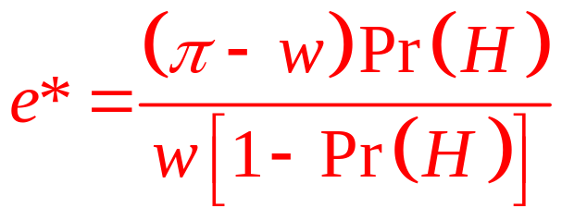
8.9 Hybrid Equilibria in the Job-Market Signaling Game
Hybrid equilibrium
  Type H always to obtain an education
  Type L to randomize
    Between playing E and NE with probabilities e and 1 – e
  Player 2’s strategy
    Offer a job to an educated applicant with probability j
    Not to offer a job to an uneducated applicant

Slide 88
Experimental Games
Experimental economics
  Explores how well economic theory matches the behavior or experimental subjects in a laboratory setting
  Play in the Prisoners’ Dilemma converged to the Nash equilibrium as subjects gained experience
  Results from the Ultimatum game suggests that fairness matters

Slide 89
Evolutionary Games And Learning
Evolutionary model
  Players do not make rational decisions
    They play the way they are genetically programmed
  The more successful a player’s strategy in the population
    The more fit is the player
    The more likely will the player survive to pass his or her genes on to future generations

Slide 90
Evolutionary Games And Learning
Learning model, players
  Are matched at random with others from a large population
  Use their experiences of payoffs from past play
  Are assumed to have a degree of rationality
  Are not fully rational

Slide 91
Existence of Nash equilibrium
A function
  Maps each point in a first set to a single point in a second set
A correspondence
  Maps a single point in the first set to possibly many points in the second set
  E.g.: the best response

Slide 92
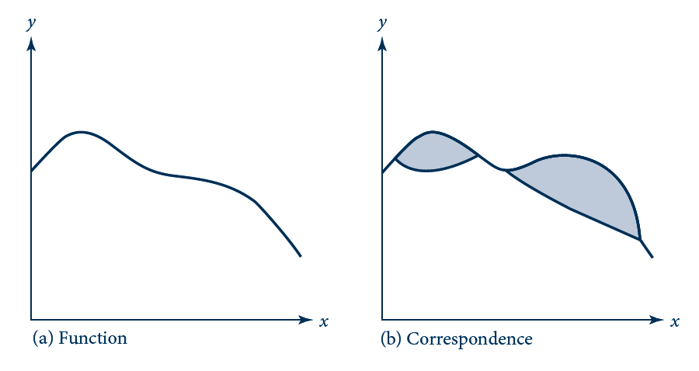
E 8.1 Comparison of Functions and
Correspondences
The function graphed in (a) looks like a familiar curve. Each value of x is mapped into a single value of y. With the correspondence graphed in (b), each value of x may be mapped into many values of y. Thus, correspondences can have bulges as shown by the shaded regions in (b).

Slide 93
Existence of Nash equilibrium
Kakutani’s fixed point theorem
  Any convex, upper-semicontinuous correspondence [ f(x)]
  From a closed, bounded, convex set into itself
  Has at least one fixed point (x*) such that x*Є f (x)

Slide 94
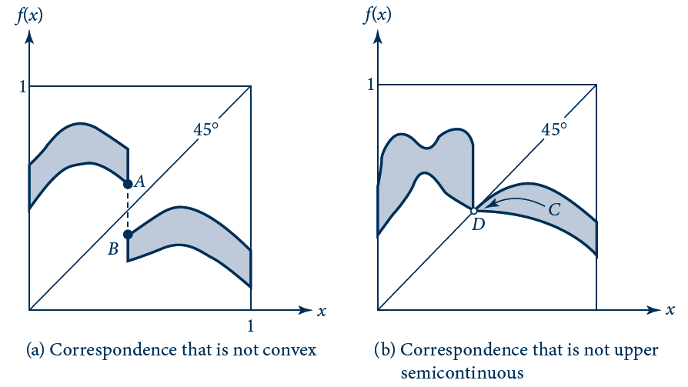
E 8.2 Kakutani’s Conditions on Correspondences
The correspondence in (a) is not convex because the dashed vertical segment between A and B is not inside the correspondence. The correspondence in (b) is not upper semi-continuous because there is a path (C) inside the correspondence leading to a point (D) that, as indicated by the open circle, is not inside the correspondence. Both (a) and (b) fail to have fixed points.

Slide 95
Existence of Nash equilibrium
R(s)- the correspondence that underlies Nash’s existence proof
  Takes any profile of players’ strategies s = (s₁, s₂,…, s_{n})
  And maps it into another mixed strategy profile - the profile of best responses:
R(s) = (BR₁(s₋₁); BR₂(s₋₂), . . . , BR_{n}(s_{-n}))

Slide 96
Existence of Nash equilibrium
Nash equilibrium
  A fixed point of the correspondence is a strategy for which s* Є R(s*)
    Each player’s strategy is a best response to others’ strategies
The proof
  Checks that all the conditions involved in Kakutani’s fixed point theorem are satisfied by the best-response correspondence R(s)

Slide 97
Existence of Nash equilibrium
The proof
  Show that the set of mixed-strategy profiles is closed, bounded, and convex
  Check that the best-response correspondence R(s) is convex
  Check that R(s) is upper semicontinuous

Slide 98
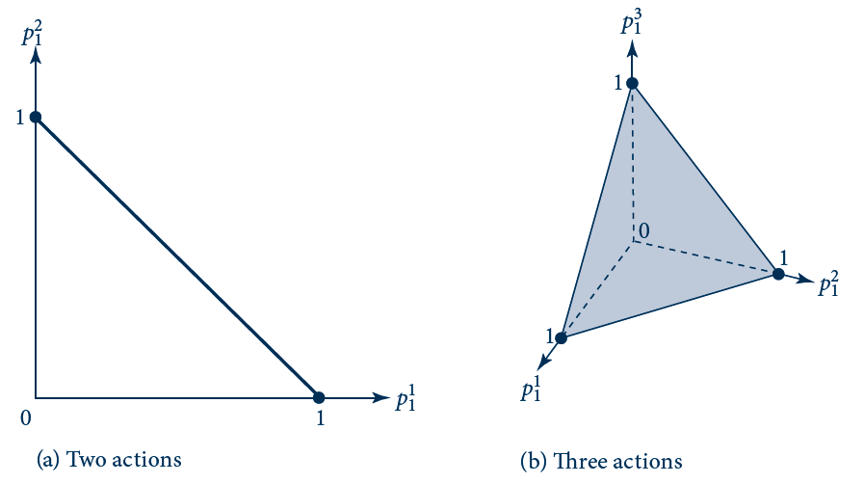
E 8.3 Set of Mixed Strategies for an Individual
Player 1’s set of possible mixed strategies over two actions is given by the diagonal line segment in (a). The set for three actions is given by the shaded triangle on the three-dimensional graph in (b).

